Slide 1

Economic Development Board
Support for Trade Promotion and Marketing Scheme (TPMS)
Oct 2020

Slide 2



Accelerating Business Anywhere,
Anytime
Support for Trade Promotion and Marketing Scheme (TPMS) Guidelines

Slide 3
Document Structure
Objective:
The purpose of this document is to guide applicants with the submission of TPMS Claims the e-licensing platform.
Document Structure:
Section 1 The e-Licensing Platform
Section 2 User Registration Process to use the E-Licensing Platform
Section 3 Submission of Claims
Section 4 Provide Clarifications
Section 5 Additional Features
Disclaimer: The images of the screens used in this user manual are for reference only. Actual Business and Agency Portal screens may vary due to product enhancement.

Slide 4
Section 1: The e-Licensing Platform

Slide 5

e-Licensing Concept
Review and modernize the processes of several business licenses / permits and allow for online submission of claims for schemes.
Review of systems, procedures and guidelines to facilitate the doing of business.
Improving the journey of businesses applying for permits and licences
Applying Business Process Management methodologies to re-engineer and streamline administrative operations

Slide 6
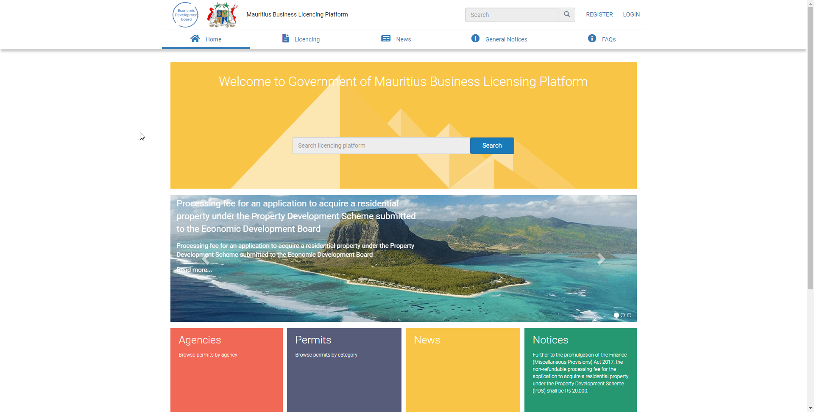

One-stop portal
for managing business licenses and permits lifecycle.
The electronic platform enables license/ claims process automation, online payment of fees and issuance of electronic permits.
Digital interaction with licensing officers during application process
Apply and renew
Access current/past applications and licenses and payments

Slide 7
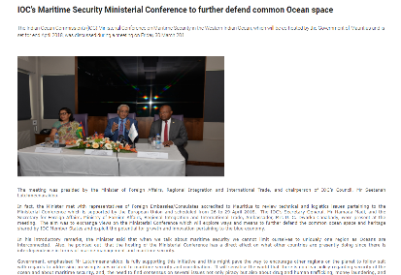
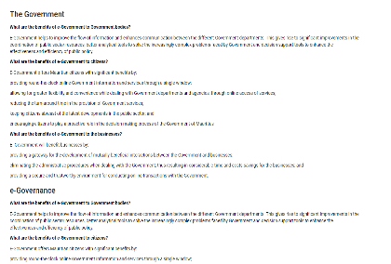
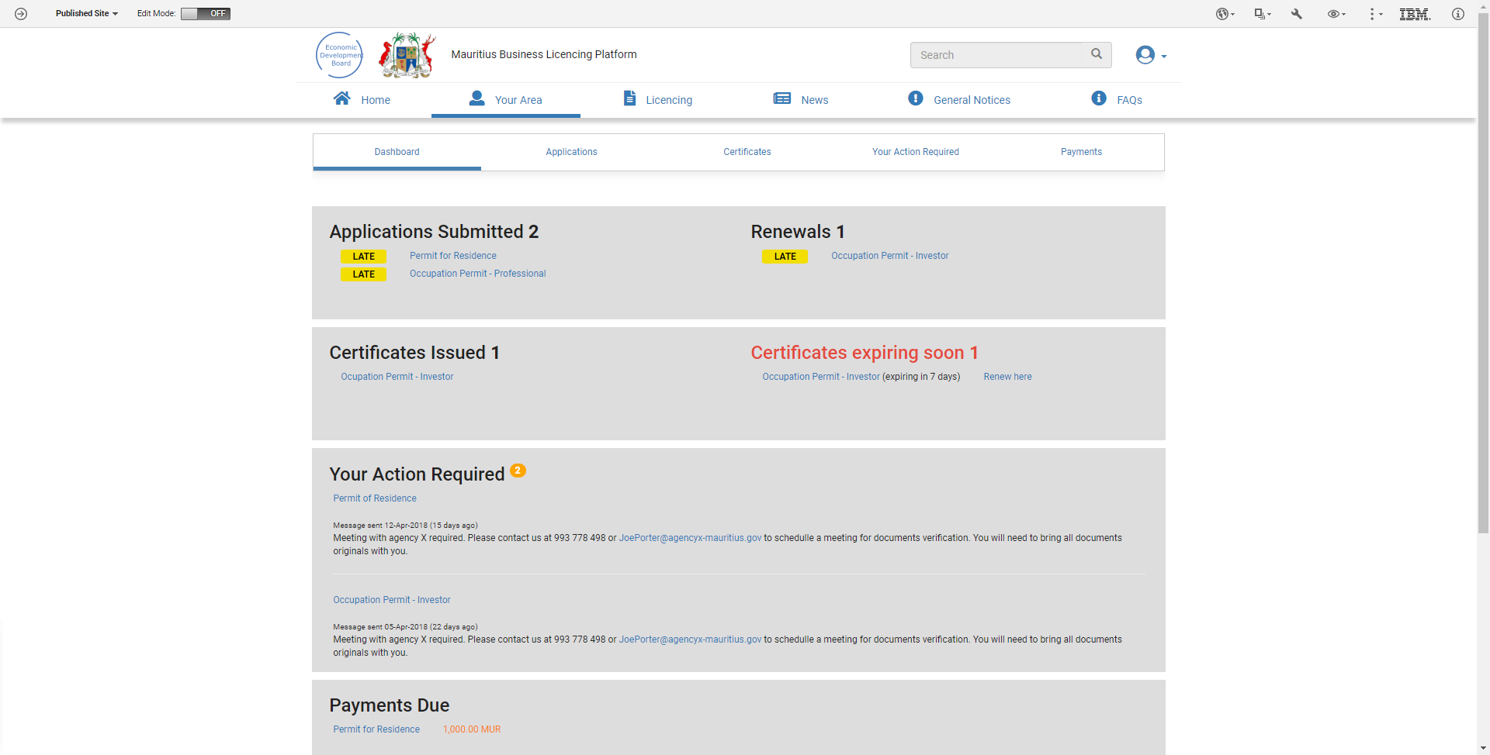
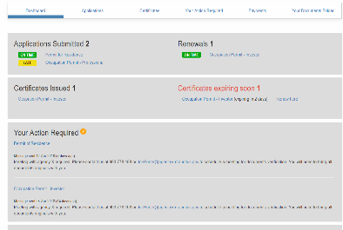
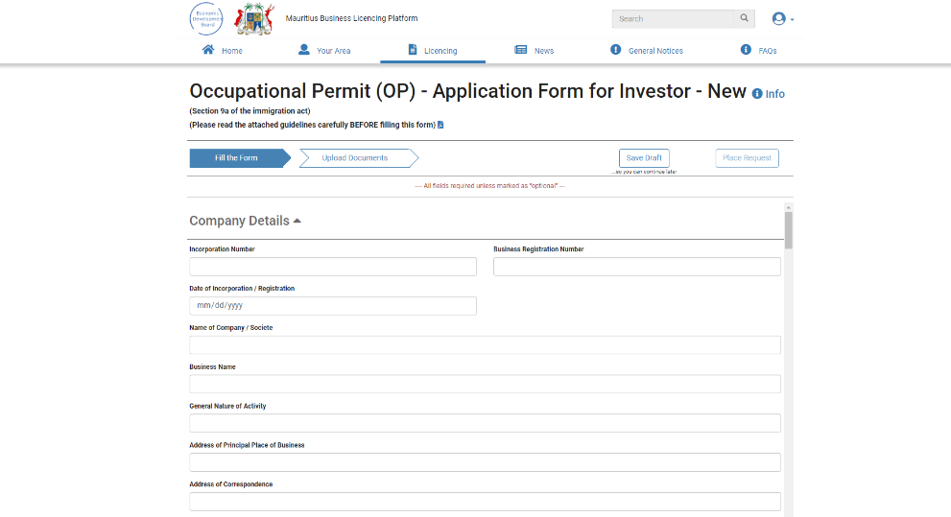
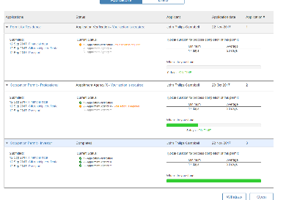
Business Portal
Mauritius Business Licensing Platform
Licensing

Slide 8

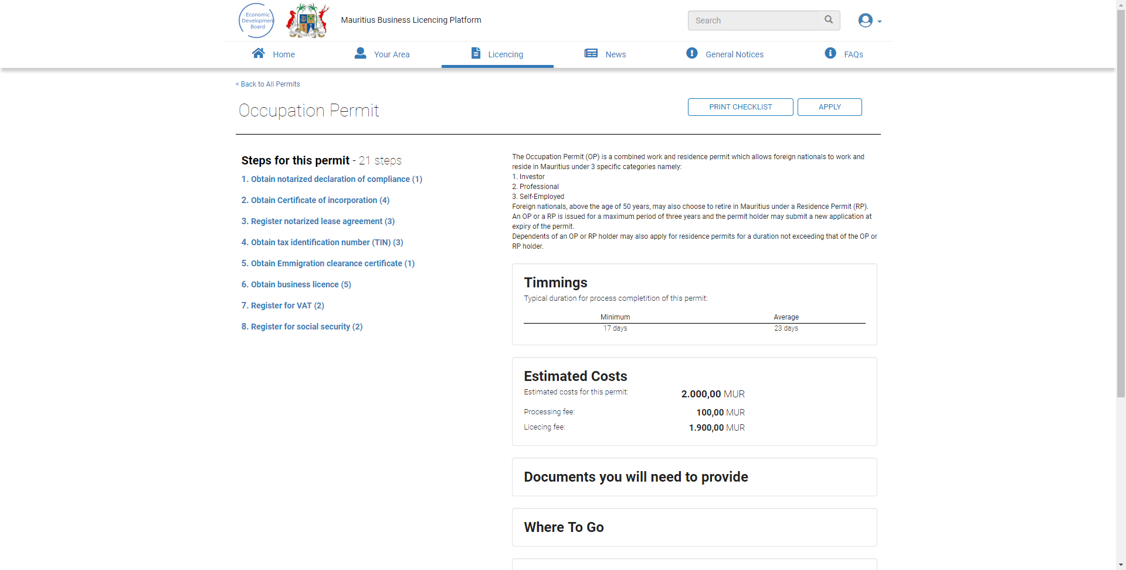
Step-by-step guide
to the licence/claim specific process and requirements
Providing easy to find information, to easily find anything they need, avoiding overwhelming the user with more information than he wants
Unique content hierarchical organization for all agencies to improved readability and user comprehension
Distributed web content management to public agencies to manage their licence’s standard guidelines for publishing as e-regulations

Slide 9
Section 2: User Registration Process
E-Licensing

Slide 10
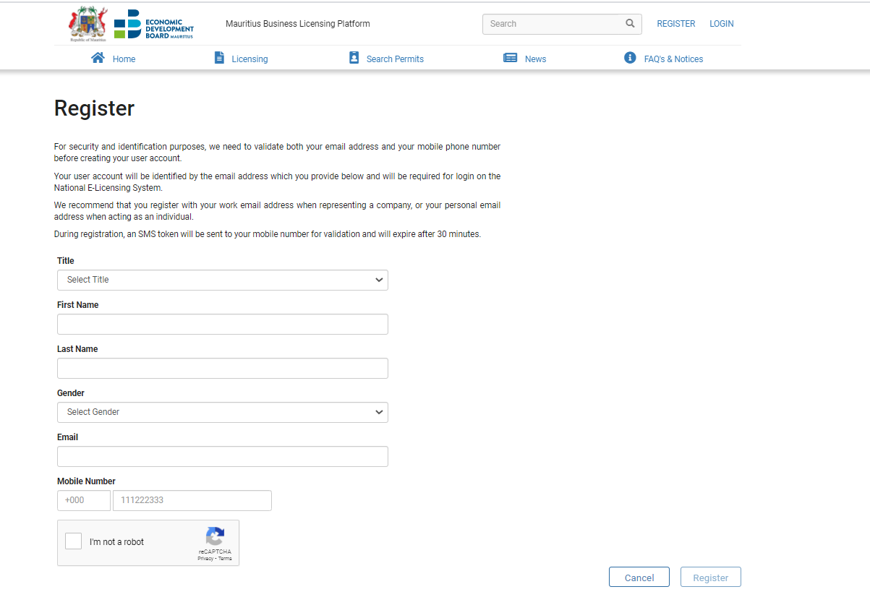
Section 2 - User Registration Process
Description: This process describes the registration process of a new user to use the E-Licensing Platform to submit claims.
Participants: Applicant
1
2
Actions:
The applicant logs in to Business Portal;
He clicks on the option “Register” at the top-right corner.
He fills in the Registration Form and clicks on the “Register” button.
3
3

Slide 11
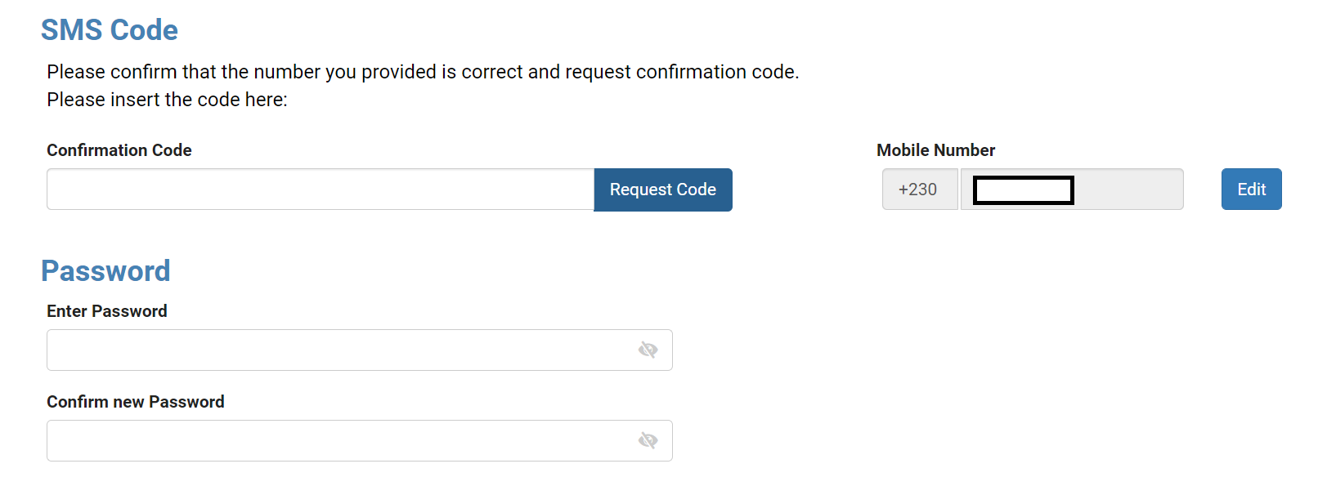
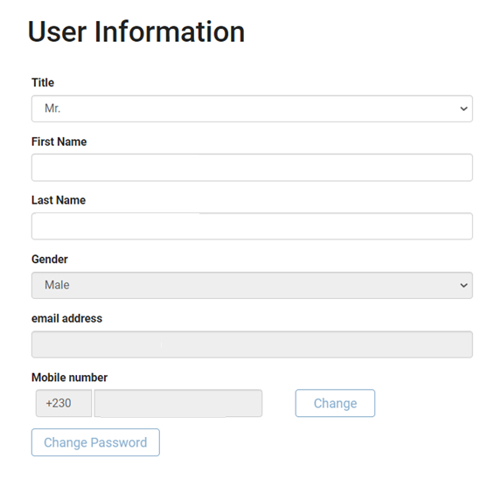
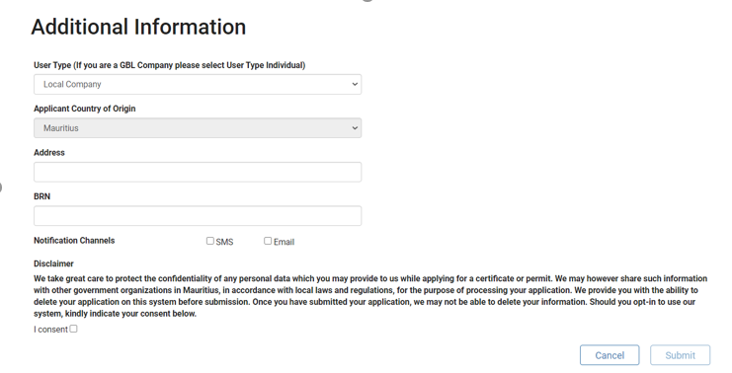
Section 2 - User Registration Process
Description: This process describes the registration process of a new user to use the E-Licensing Platform to submit claims.
Participants: Applicant
Actions:
The applicant clicks on “Request Code” to receive the confirmation code on the mobile number input;
He will have to create a password for the account and confirm it on the system.
The applicant will be prompted to log in to complete the registration process to fill in his personal details.
Additional info like: Type of User (Individual/Company/Global Business), Address, National Identity Card/Business Registration Number, Notification channels should be filled in.
Once the “Submit” button is clicked, the registration process is deemed complete and the applicant can log in on the E-Licensing Platform to submit a claim.
1
1
2
2
3
4
5

Slide 12
Section 3: Submission of Claims

Slide 13
Section 3 - Submission of Claims
Description: In order to submit a claim, the applicant shall follow the sub steps shown in the diagram below.
Participant: Applicant
Step 1 - Submit Application
3.1.Select Scheme and Apply
3.2.Fill the Form
3.3.Upload Documents
3.4.Place Request
End

Slide 14
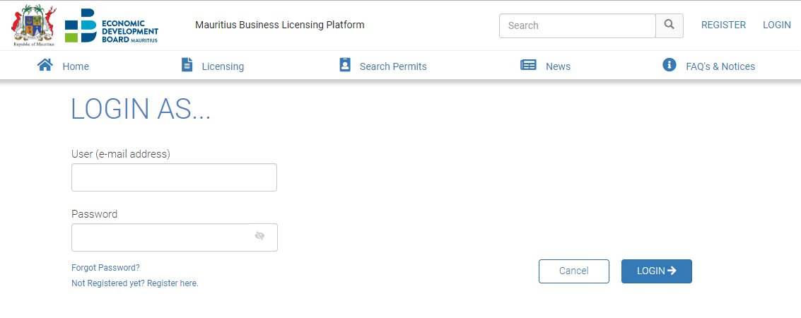

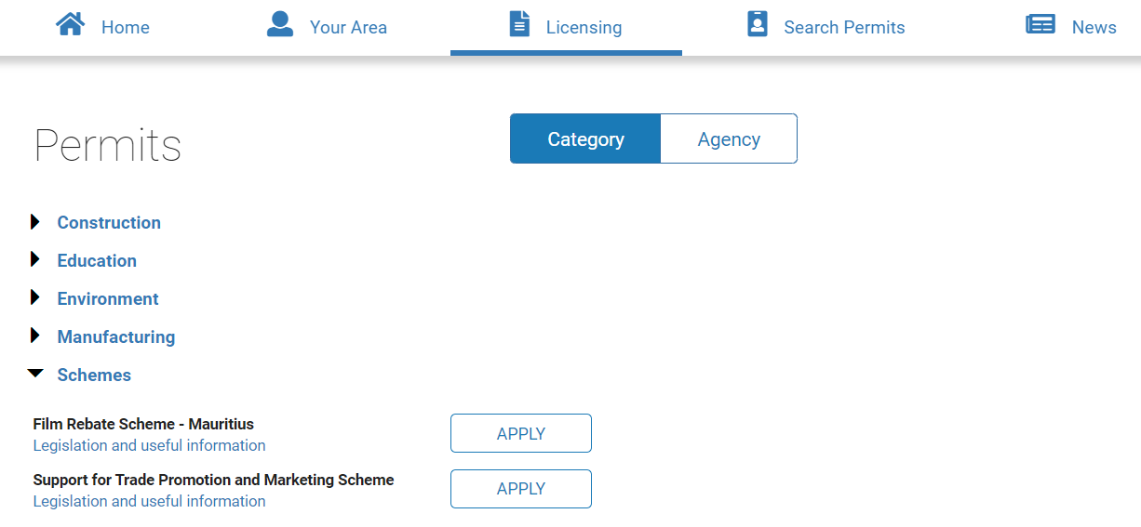


Section 3 – Submission of Claims: 3.1 Select Scheme and Apply
Description: The Applicant shall search for Support for Trade Promotion and Marketing Scheme to submit his application. Below are the steps required to search and submit a claim.
Participant: Applicant
Actions:
The applicant logs in to Business Portal;
He clicks on the option “Licensing”
He selects “Schemes” section under “Category”
He clicks on the button “Apply” next to “Support for Trade Promotion and Marketing Scheme”.
1

Slide 15
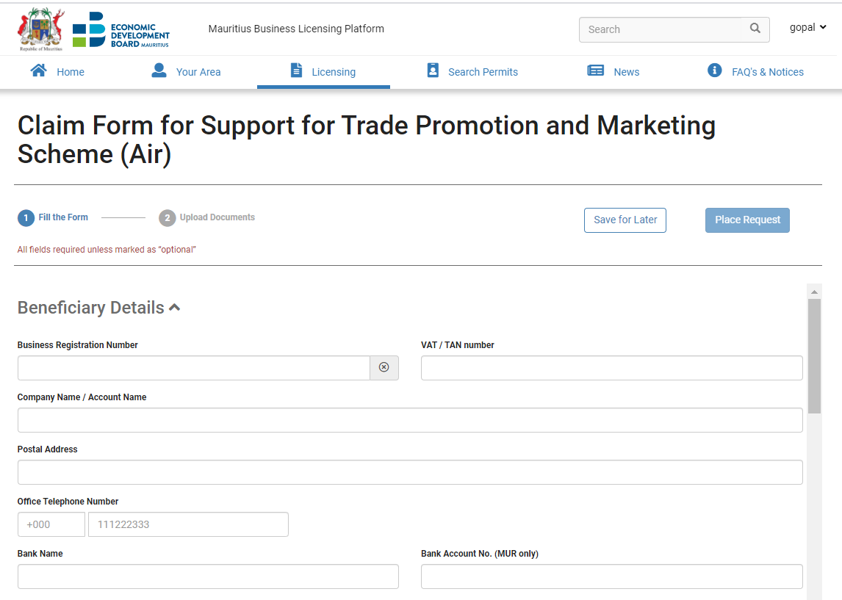

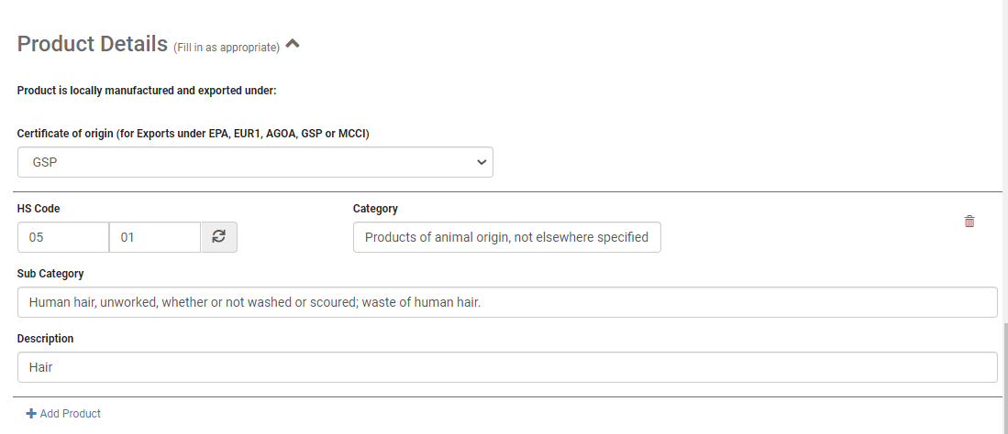
Section 3 – Submission of claims: 3.2 Fill the form
Description: The Applicant shall start filling in the application form.
Participant: Applicant
Actions:
All mandatory fields need to be filled in by the applicant;
After inputting his Business Registration Number, the applicant can click on the lookup button for the system to automatically retrieve the Company Name and Postal Address from the CBRD.
The applicant needs to input only the first 4-digits of the HS Code and click on the lookup button to retrieve its associated details : Category and Sub-Category will automatically be populated.
An applicant may add as many HS Codes as he wish in a form by clicking in on the “Add Product” button.
To delete an HS Code entry, the applicant must click on the trashcan icon to the right.
5

Slide 16
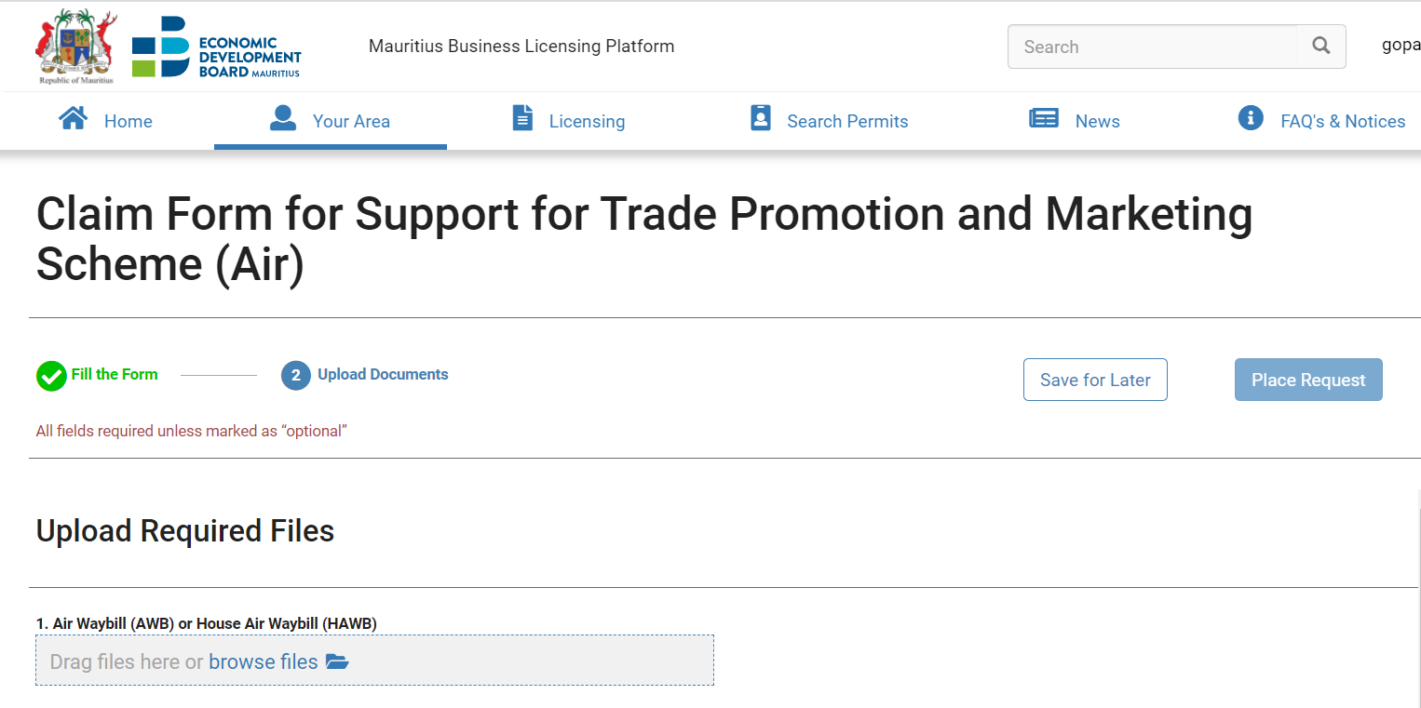


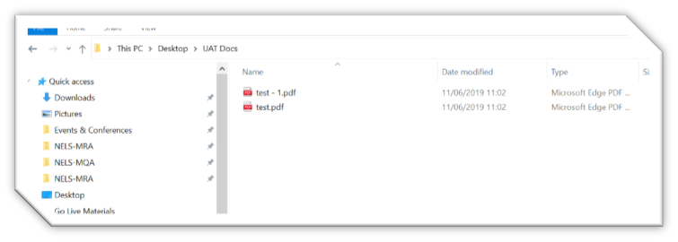

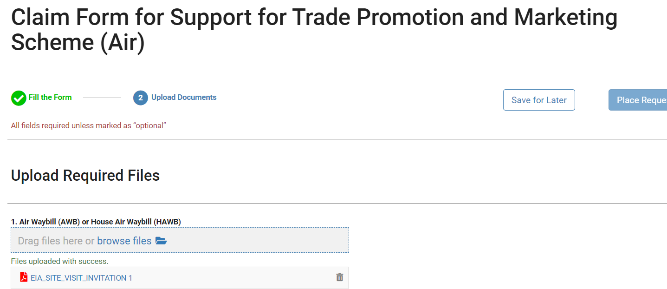
Section 3 – Submission of Claims: 3.3 Upload Documents
Description: Upload Documents required for
the application
Participant: Applicant
Actions:
The applicant afterwards uploads the mandatory documents and any other optional document that may be relevant to the application.
Upload documents:
  1.1. Click on the “Upload Documents” section.
  1.2. All documents are required unless they are marked as “optional”;
  1.3. To upload a file, the applicant either selects the option to browse files or to drag the file and drop it in the correspondent document box;
  1.4. The applicant can upload one or more files for each document;
  Note:
  (i) Only PDF documents can be uploaded on the system and they should not exceed 25MB.
  (ii) In case applicant does not have certificate of origin, he needs to upload a memo indicating same.
1.4

Slide 17
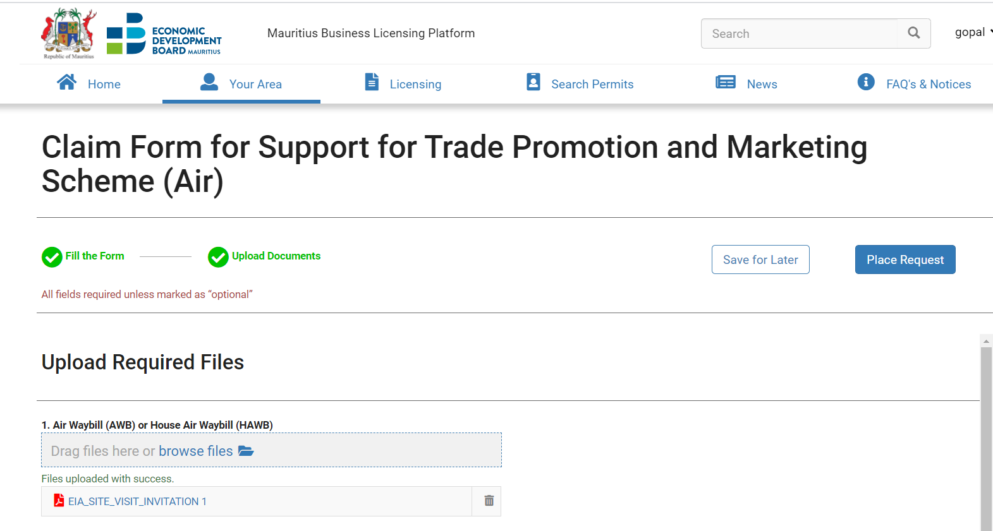

Section 3 – Submission of Claims: 3.4 Place Request
Description: After completing the form, the applicant needs to place the request. It will afterwards go for processing.
Participant: Applicant
Actions:
Once all the details for the application have been submitted successfully, the “Fill the form” and “Upload Documents” section will turn green; this means that the application is complete.
Navigation bar and step completion color codes:
  To navigate between the application form and the upload documents form use the actions "Fill the Form" and "Upload documents" that are available in the navigation bar;
  The navigation bar has the following color codes:
    Blue – current selected form;
    Yellow – form incomplete;
    Green – form complete;
The applicant then clicks on “Place Request”
and the application is submitted
1
1

Slide 18
Section 4 Provide Additional Information

Slide 19
Section 4 – Provide Additional Information
Description: The Applicant can be requested to provide additional clarifications after the verification of application by the Claim Officer. In order to provide clarifications, the applicant shall follow the sub steps shown in the diagram below.
Participant: Applicant
End
Start
End
Start
4.B Provide Clarifications
3. B Provide Clarifications
4.C Send New Info
4.A Select / Open Application
3. C Send New Info
3. A Select / Open Application

Slide 20
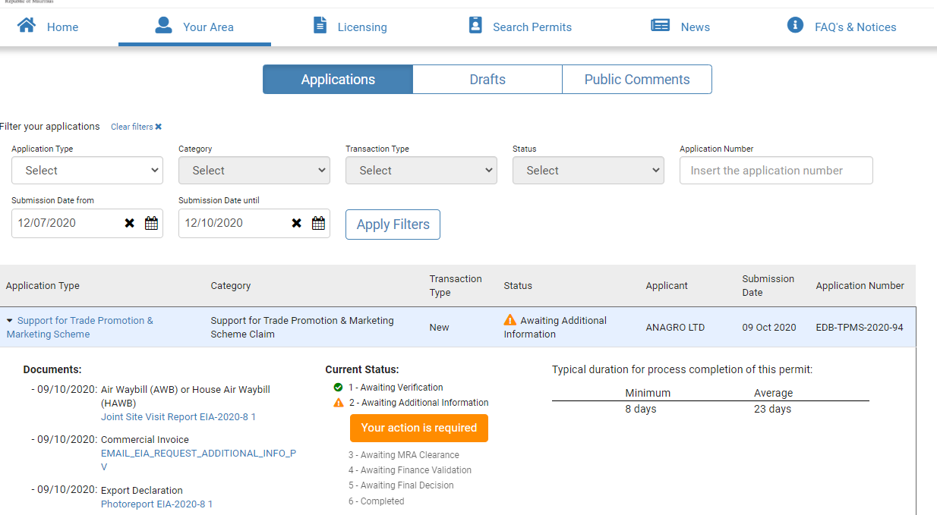
Section 4 – Provide Additional Information > 4.A Select/Open Application
Description: In this activity, the applicant receives a notification informing him that he needs to provide additional information/clarification.
Participant: Applicant
1
Actions:
Applicants can log on the system at any moment to track their application status.
After login, they click on “Your Area” tab to search for the application under “Applications” section.
Applications can be searched using the following criteria: Application Type, Category, Transaction Type, Status, Application Number, Submission Date From, Submission Date To
The following search result is obtained after applying the filter.
The search result displays:
    The documents that were attached;
    The current status (yellow status implies awaiting information from the applicant);
3
2
4.2
4.1

Slide 21
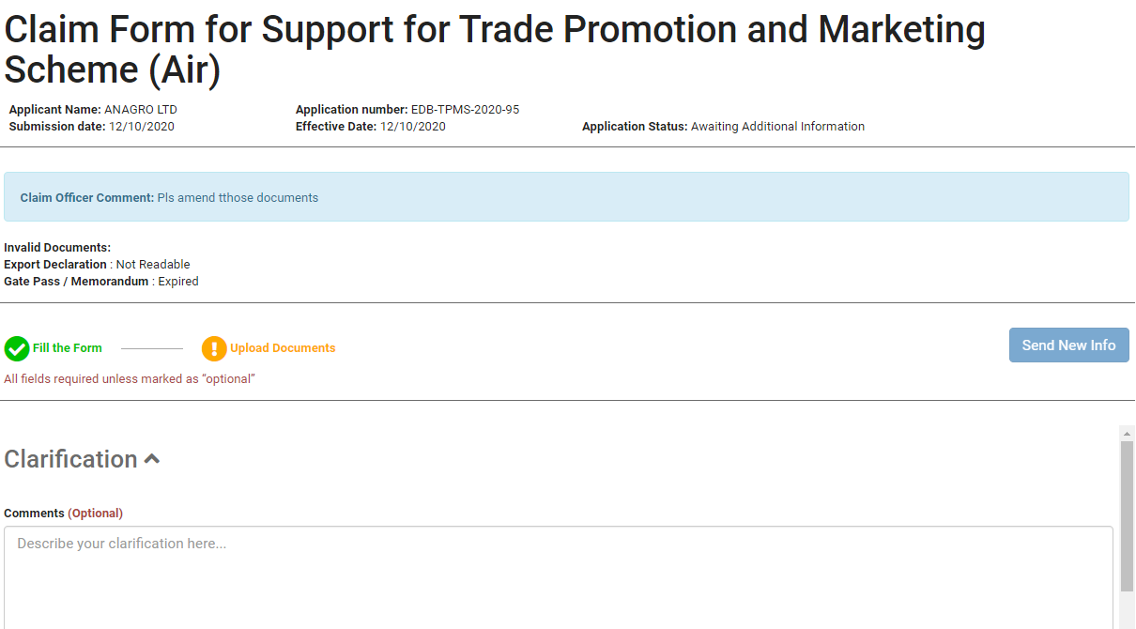
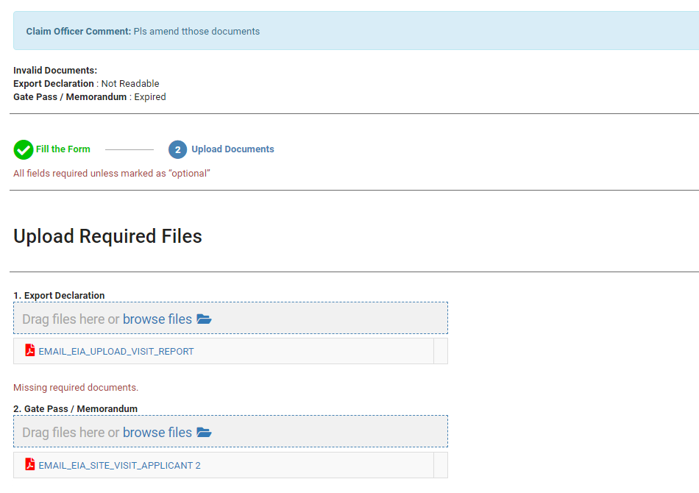
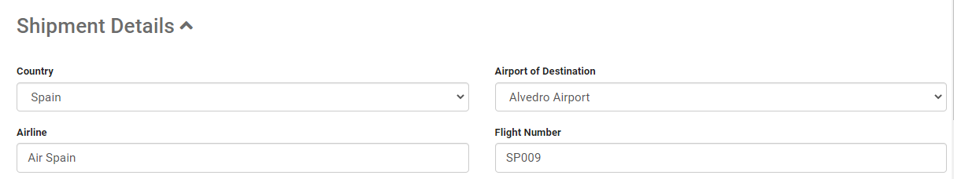
Section 4 – Provide Additional Information > 4.B Provide Clarifications
Description: In this activity, the applicant will click on the option “Your Action is required“ under “Your Area”. He will then provide the required clarification/information for the application.
Participant: Applicant
Actions:
When opening the application form, the applicant will see the comments input by the Claim Officer together with the list of incorrect documents.
The Applicant can change details under Shipment & Product details in the application form.
A Clarification box is available for the Applicant, so that he can input any comment for the claim officer.
To attach the missing documents, the Applicant must click on the “Upload Documents” tab. Only the incorrect documents will be able to be amended.
1
4
3
2

Slide 22
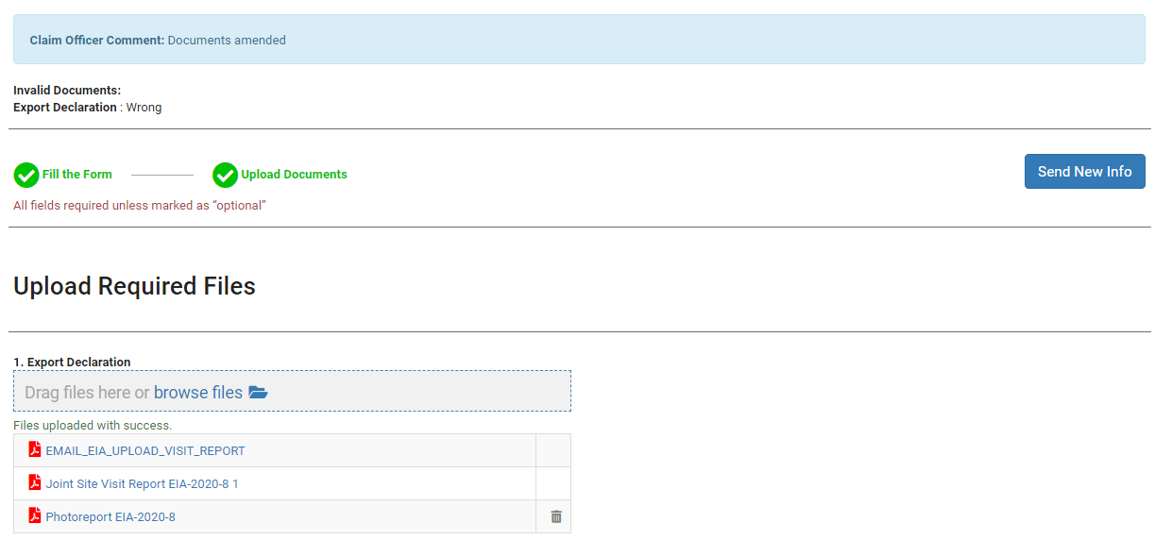
Section 4 – Provide Additional Information > 4.C Send New Info
Description: In this activity, the applicant will identify what information is required from them.
Participant: Applicant
Actions:
The missing documents can be uploaded by clicking the browse files link and attach the document.
The documents that are allowed to be uploaded by the applicant at this stage, will be the ones invalidated by the Claim Officer and the Optional ones that the applicant did not upload in the first phase.
The Applicant then clicks on the “Send New Info” button to submit the application again.
3
2
1

Slide 23
Section 5 Additional Features

Slide 24
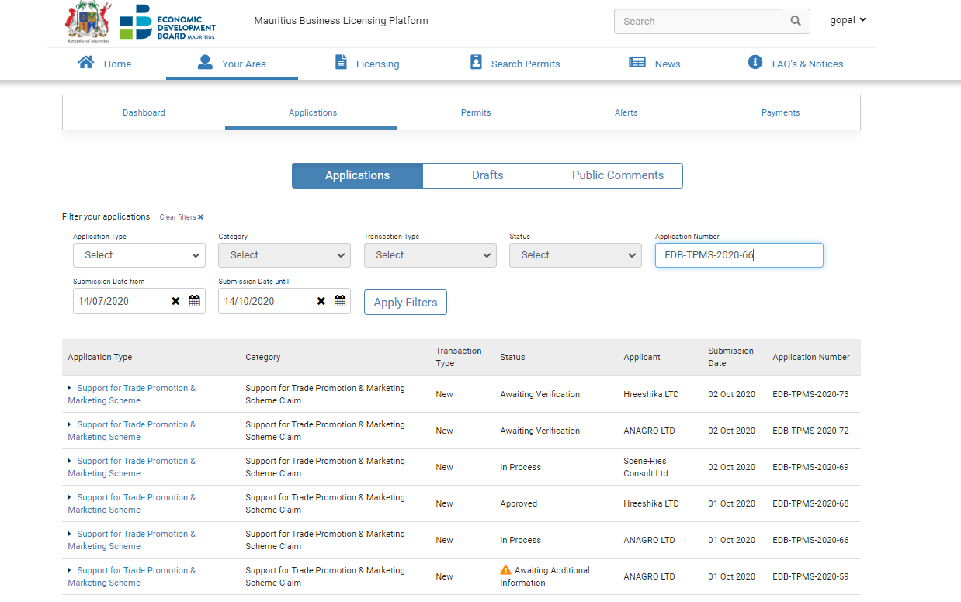
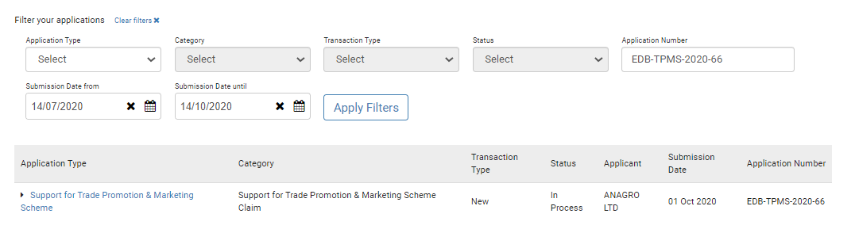
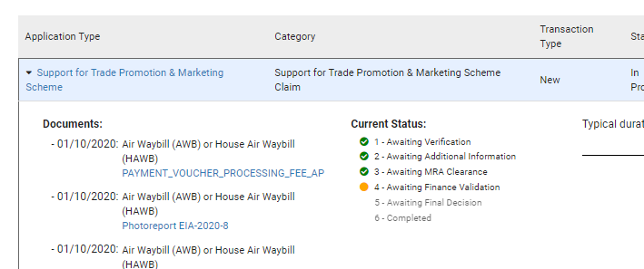
Section 5 – Additional Features: Search & View Application Status
Description: An applicant can track the progress of his claim on the E-Licensing Portal.
Participant: Applicant
2.1
Actions:
The applicant logs in on the Business Portal.
To retrieve the application:
  Go to “Your Area”.
  Go to Applications tab.
  Input an application number
  Click on “Apply Filters” button.
  Only the required application will be retrieved. A high-level status will be displayed on the dashboard.
  To view the internal status, the applicant must expand the arrow next to the application. The current status will be displayed. All completed steps will be listed in green and the current step in progress will be in orange.
2.2
2.3
2.4
2.5
2.6
2.6

Slide 25
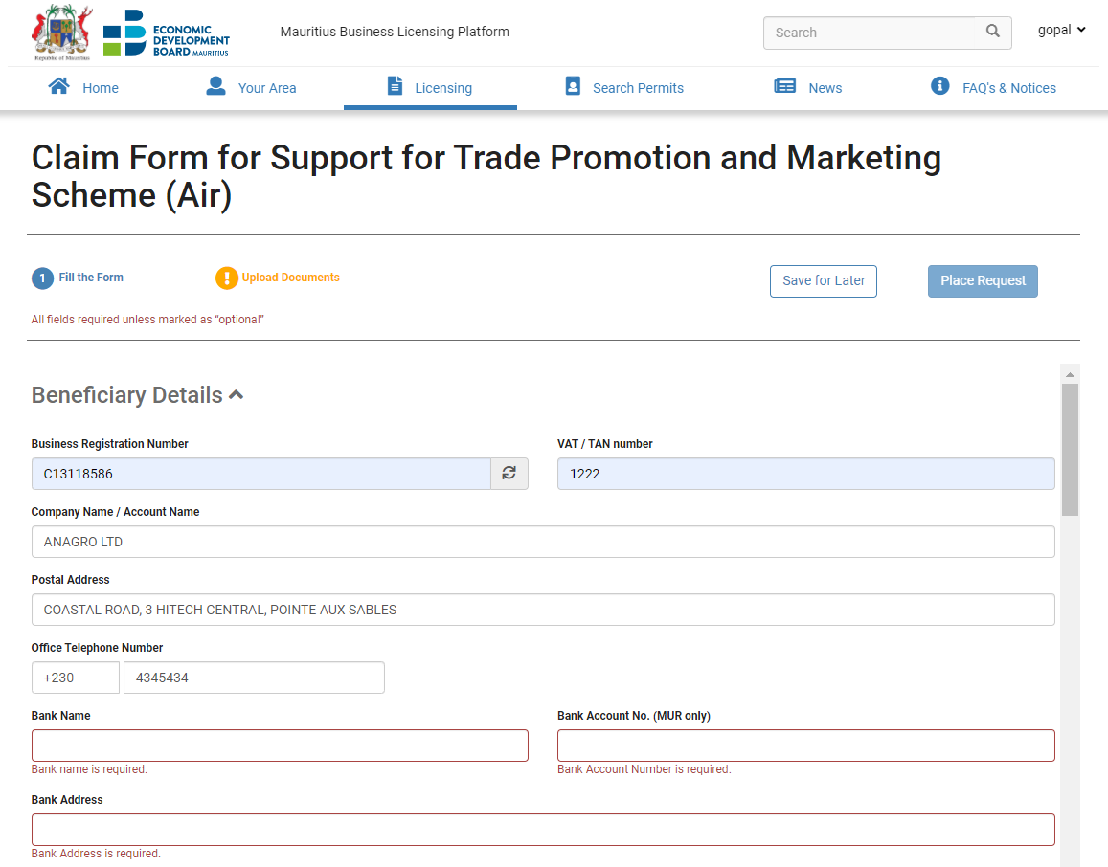
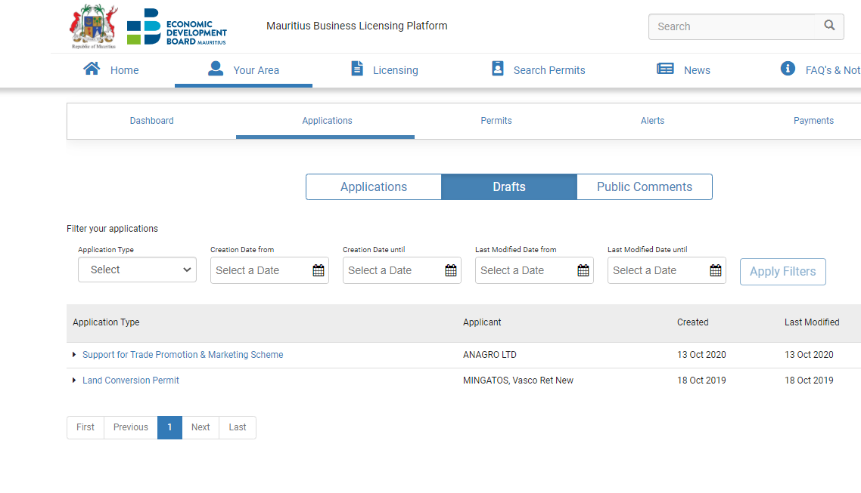
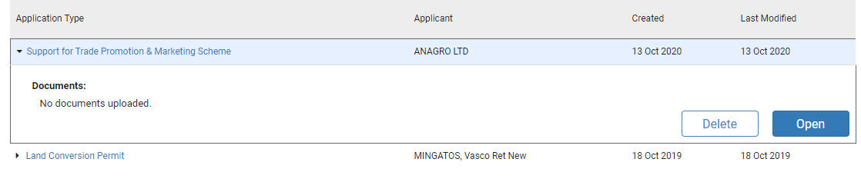
Section 5 – Additional Features: Save for Later
Description: While filling the application form, an applicant may wish to save the form to fill in later.
Participant: Applicant
Actions:
Click on the “Save for Later” button.
To retrieve the saved application:
  Go to “Your Area”.
  Click on Applications.
  Select Draft.
  Right click on arrow next to application.
  Click on the “Open” button.
2.1
2.2
2.3
2.4
2.5

Slide 26
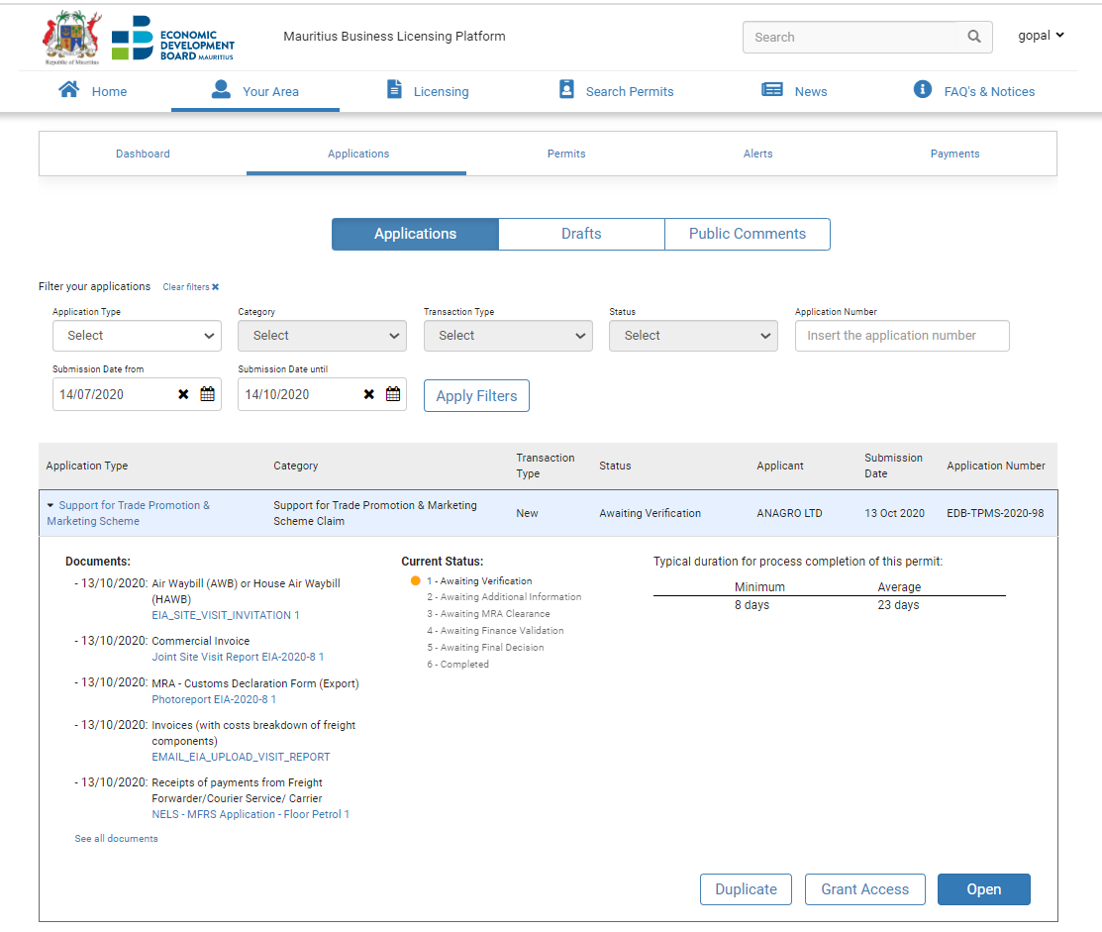
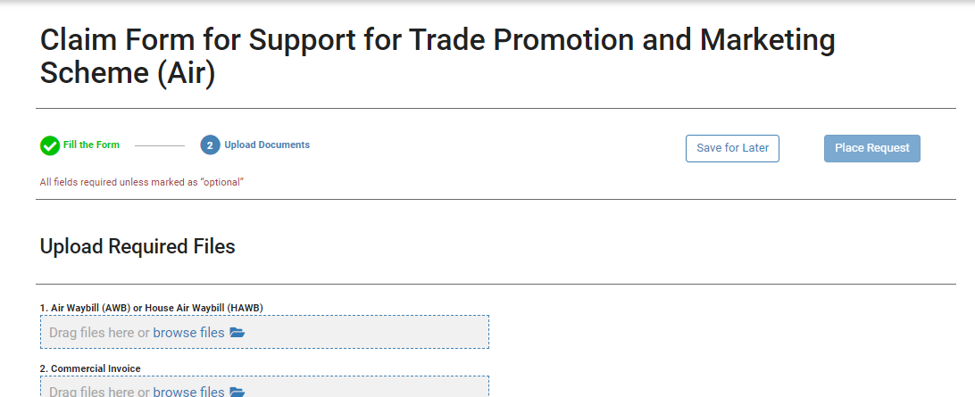
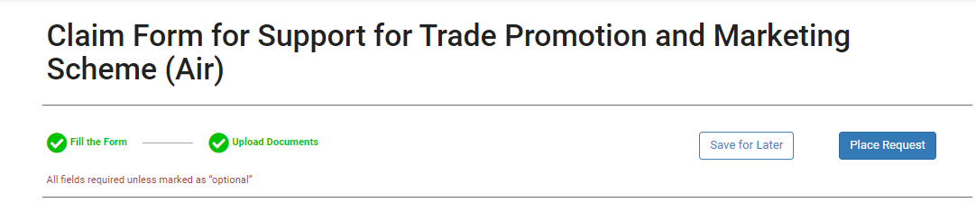
Section 5 – Additional Features : Duplicate
Description: This feature enables an applicant to duplicate an existing claim. When sending multiple claims, he does not need to fill-in his application from scratch.
Participant: Applicant
Actions:
The applicant logs in on the Business Portal.
  Go to “Your Area”.
  Go to Applications tab to view all the applications made on the platform.
  Right click on the arrow next to application he wishes to duplicate.
  Click on the “Duplicate” button.
  A new application form will be available with all existing details filled in. The applicant can make the necessary amendments on the form. However, all the documents will have to be uploaded for the new application.
  Once both sections: Fill the form and Upload documents have successfully been filled in, the “Place Request” button will be activated to submit the claim.
1.1
1.2
1.5
1.3
1.4
1.6
1.6
1.6

Slide 27
THANK YOU

